Slide 1


Slide 2
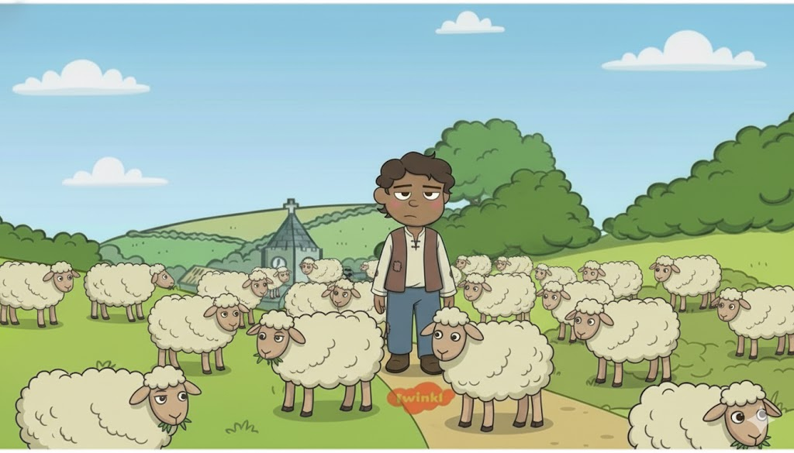

Slide 3
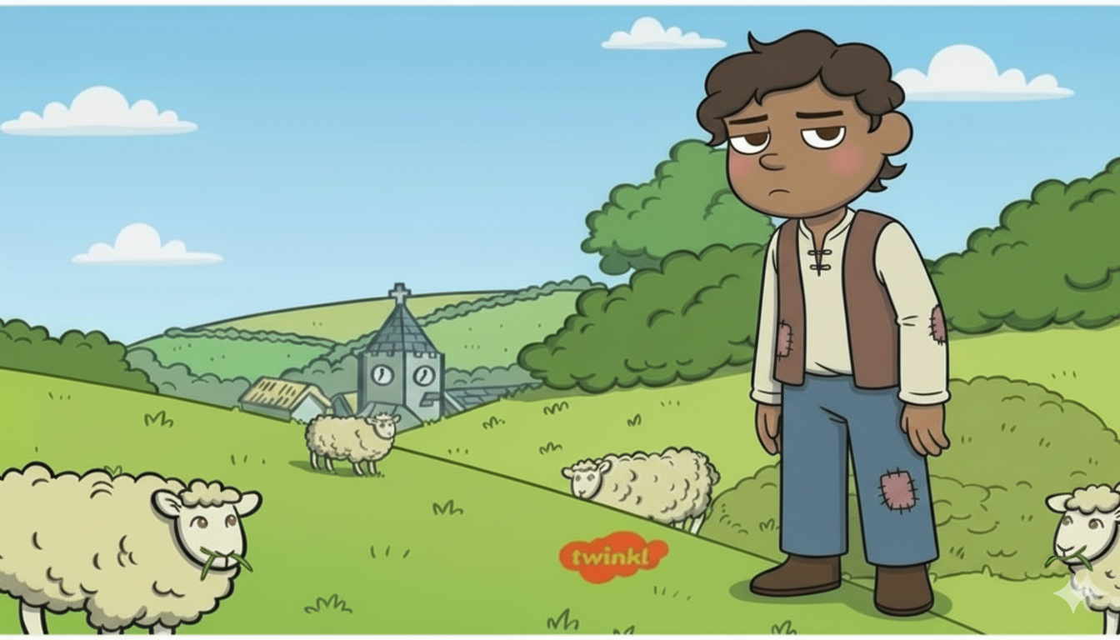
I am so bored

Slide 4
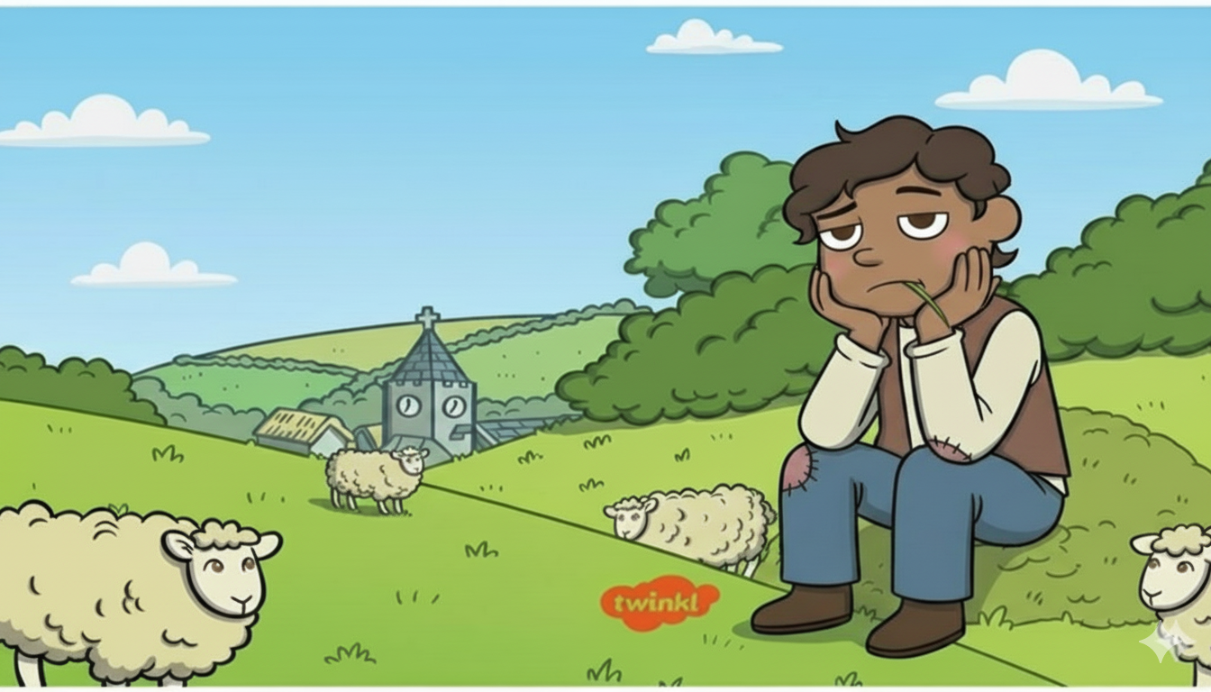
I am so bored

Slide 5
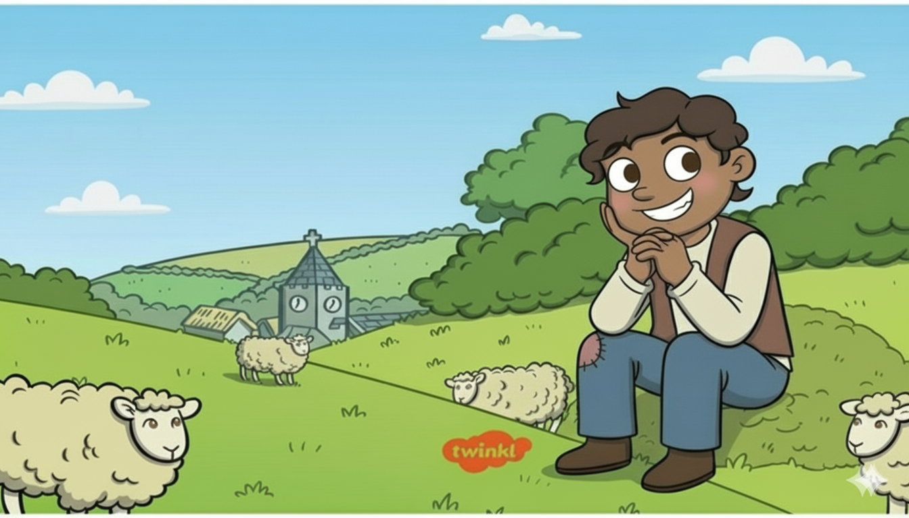
I got a great idea!!!!!
Hehehehehehe!!!

Slide 6
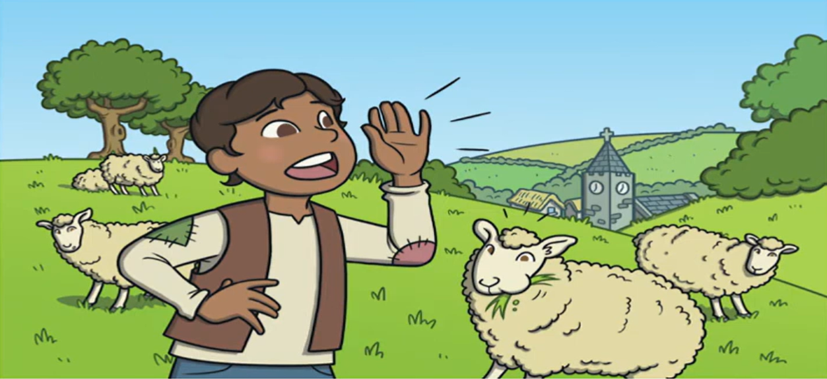
WOLF! WOLF!
HELP ME!!
NOM!
NOM!
NOM!

Slide 7
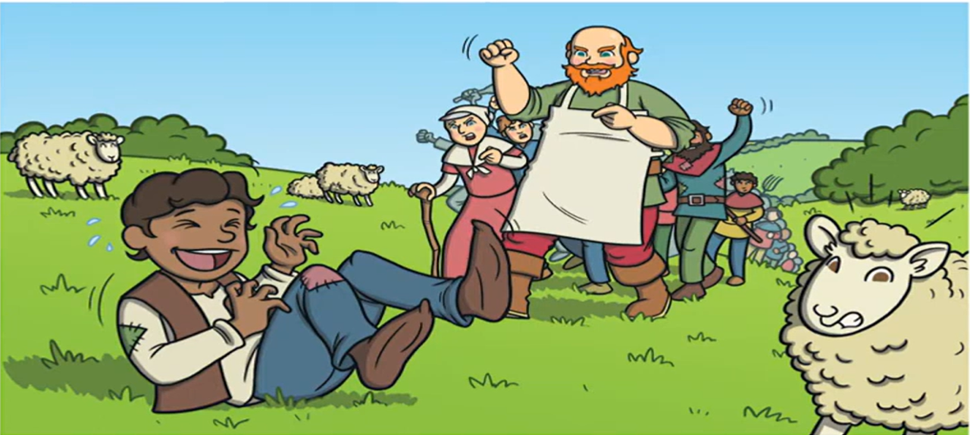
YOU MUST NOT TELL LIES!
HAHAHAHA
SO FUN!!!

Slide 8
Few days later….

Slide 9
I am so bored again

Slide 10
Let’s prank the villagers as it was so fun last time as well Hehehehehehe!!!

Slide 11
WOLF! WOLF!
HELP ME!!
NOM!
NOM!
NOM!

Slide 12
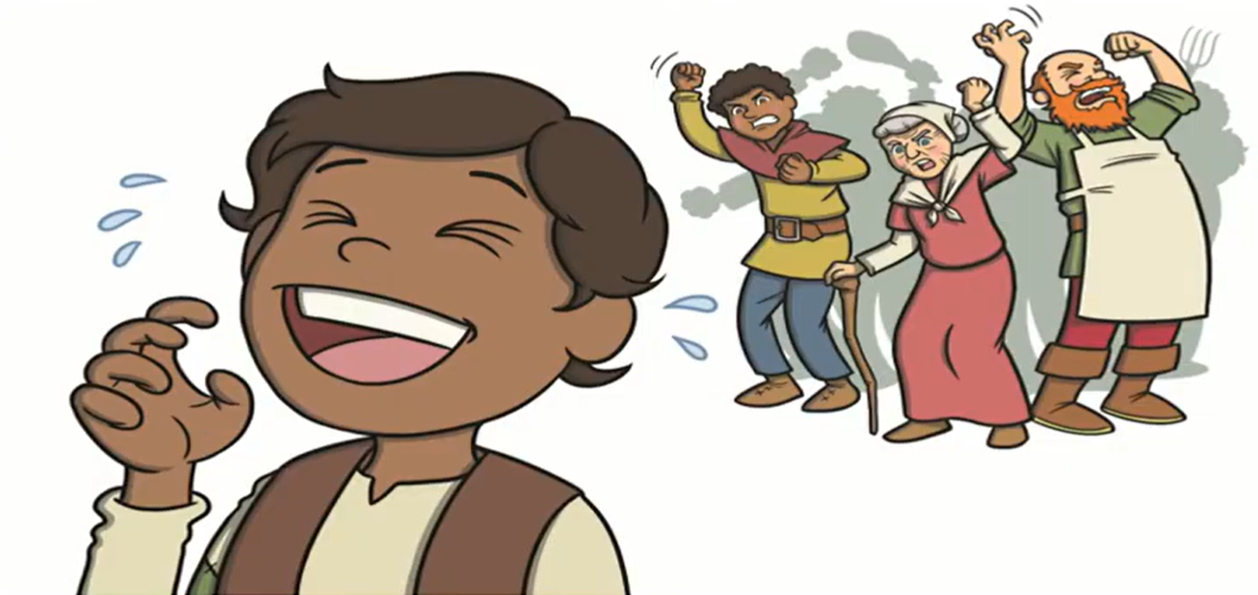
This is very Infuriating. One Day You Will Pay For This.
Not again!!!
You find this amusing!!!!!!!
HAHAHAHA
SO FUN!!!

Slide 13
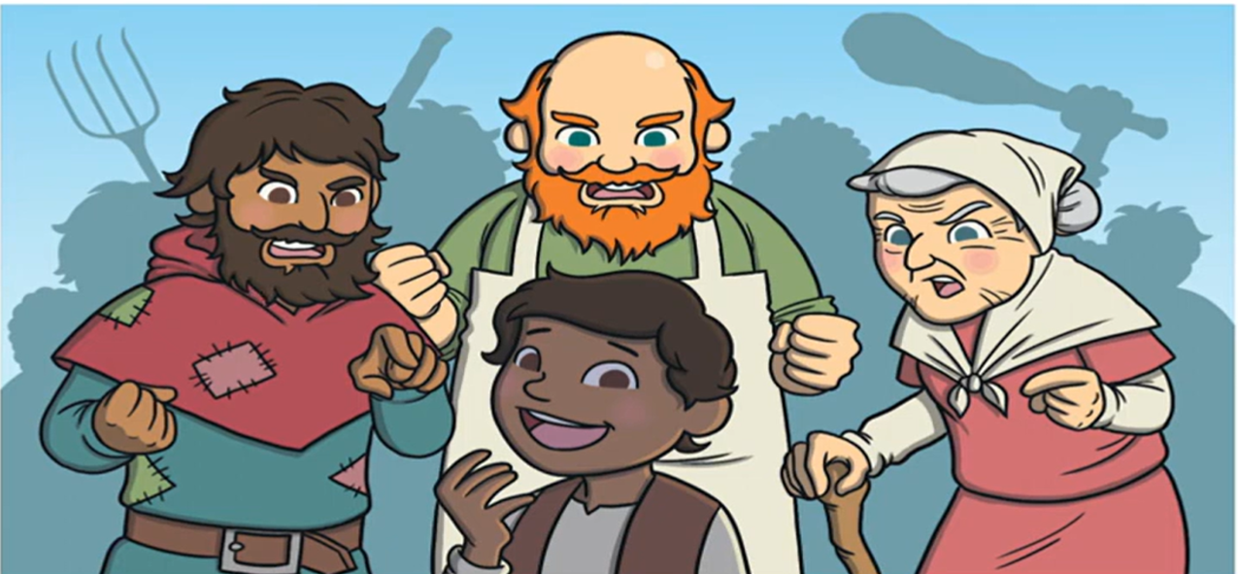
YOU MUST NOT TELL LIES!
YOU MUST NOT TELL LIES!
YOU MUST NOT TELL LIES!
HAHAHAHA
Made a fool of you all!!!

Slide 14
Some days later….

Slide 15
I am so bored

Slide 16
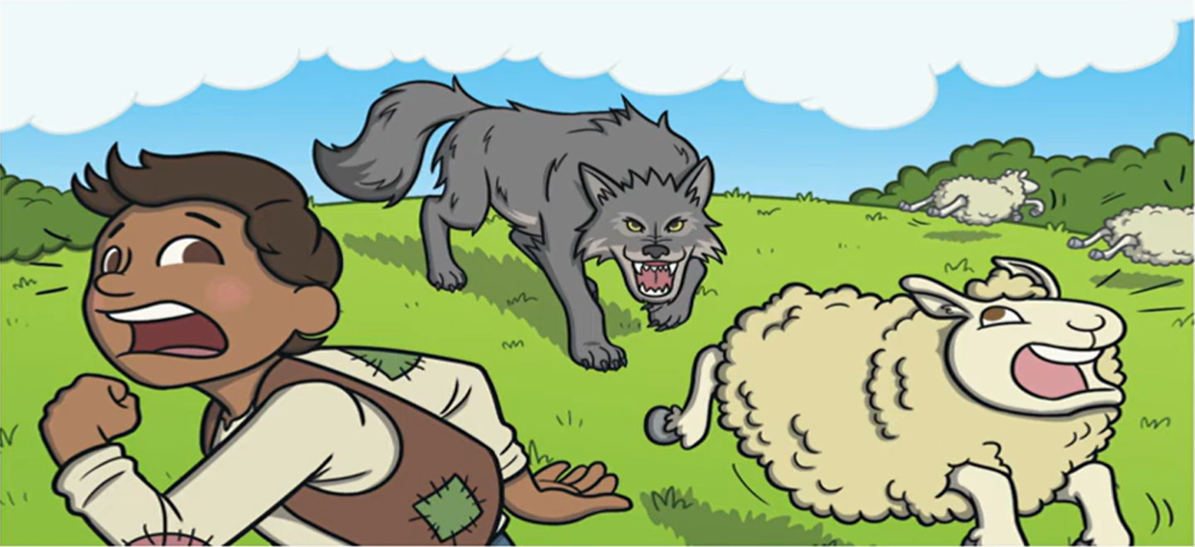
Wolf!!! Wolf!!!!
Hahahahaha
So much food
Wolf!!! Wolf!!!!

Slide 17
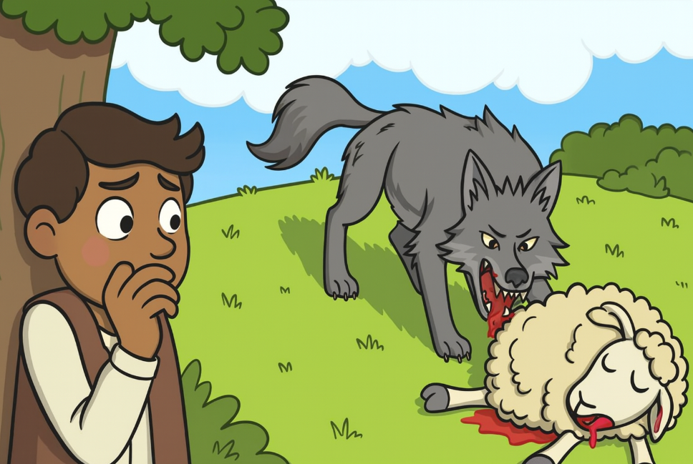

Slide 18
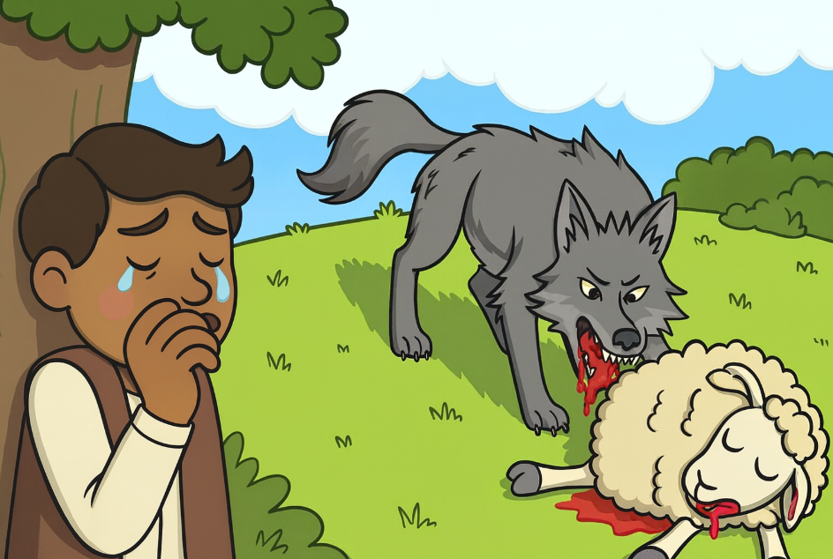
Why did no one come to help me!!!

Slide 19
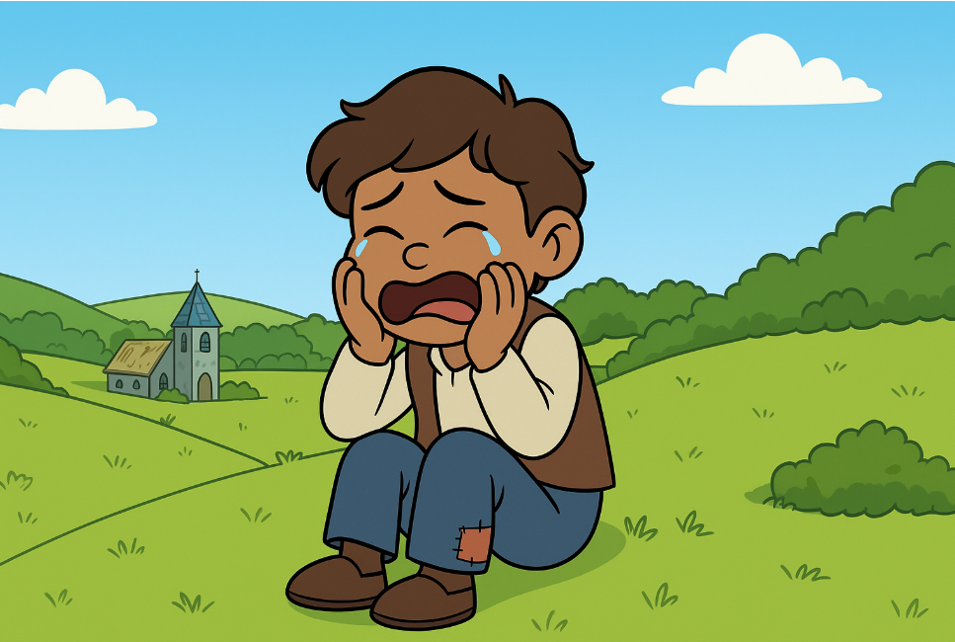


All my sheep were eaten!!!
Sobs*

Slide 20
